Slide 1
Introduction to Biology
Mrs. Crowder| Teacher’s name | LHS

Slide 2
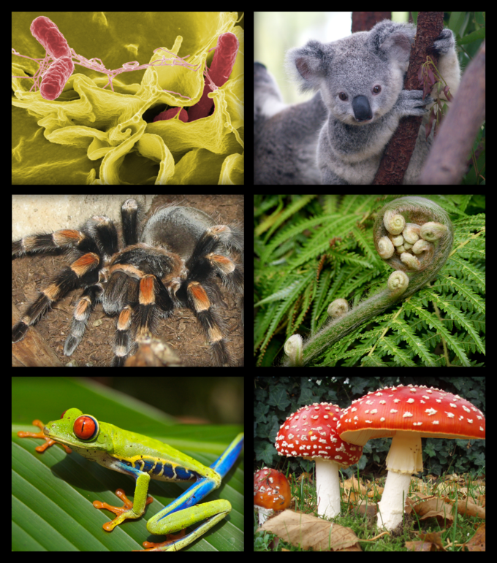
Essential Question #1: What is Biology?
Biology is the scientific study of life.
The word Biology comes from the Greek word bio – life and logos – study.
Concepts include:
1- origins and history of living things
2- how living things interact with each other
3- how living things function

Slide 3
Essential Question #2: What are possible benefits of studying biology?
Study the diversity of life – we are able to better understand other organisms which help to protect them.
Research disease – in order to find cures and medicines.
Develop technologies – to make our lives easier!
Improve agriculture – to be able to feed our worlds people.
Preserve the environment – to prevent extinctions and keep our Earth and environment clean and free of toxins and pollutants.
Notes:
Summarize your research in three to five points.

Slide 4
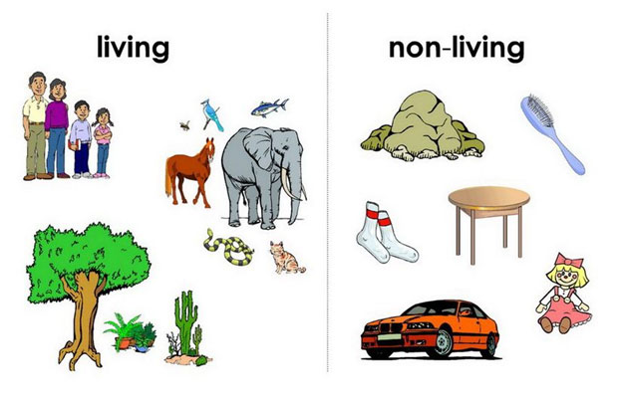
Essential Question #3: What are the characteristics of living things?
All living things share these characteristics.
An organism is an object that has all or has had these characteristics, it is a living thing.

Slide 5
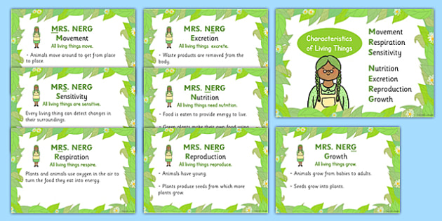

Slide 6
1) All living things are made of cells!
Cells are the basic unit of living things:
Unicellular – made up of one cell
Multicellular – made up of many cells

Slide 7
2) Living things display organization
Living organisms are arranged in an orderly way.
Organization is the arrangement of things in an orderly fashion.

Slide 8
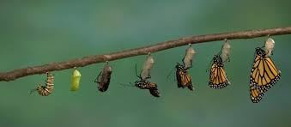
3) All living things grow and develop
Growth – results in the addition of mass to an organism and the formation of new cells and new structures.
Development – process of natural changes that take place during the life of an organism.

Slide 9
And continue…

Slide 10
Review Questions!!
1) Why is the study of biology important?
2) Describe the organization of living things starting with the cell.
3) What are three of the characteristics of living organisms?
4) What is meant by homeostasis?

