Slide 1
Chemical Reactions in Biology
Chapter 6.2

Slide 2
What are chemical reactions?
Chemical reactions occur when the atoms of a substance are rearranged to form a new substance.
In other words, the composition of a substance must change. Not necessarily the appearance of a substance, but what a substance is made of. Water can change to ice or steam, but the composition does not change. (H₂O)
Clues that a chemical change has taken place are the production of heat or light, or a formation of a new gas, liquid, or solid.

Slide 3
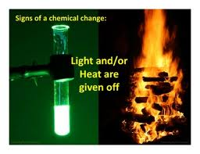
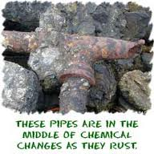
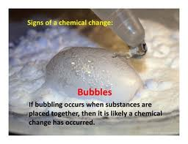
Chemical Changes

Slide 5
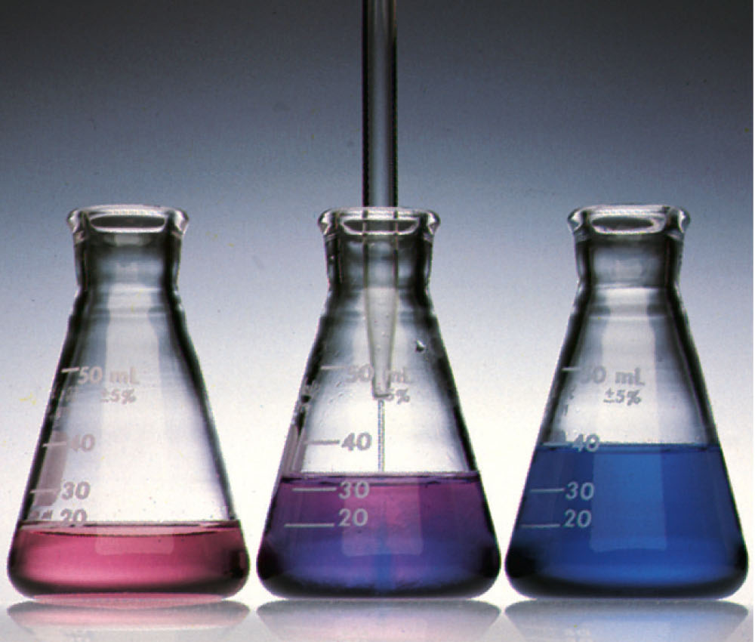
What is a clue that a chemical reaction has occurred?
“Colorless hydrochloric acid is added to a red solution of cobalt(II) nitrate, turning the solution blue.”
a) The color changes.
b) A solid forms.
c) Bubbles are present.
d) A flame is produced.

Slide 6
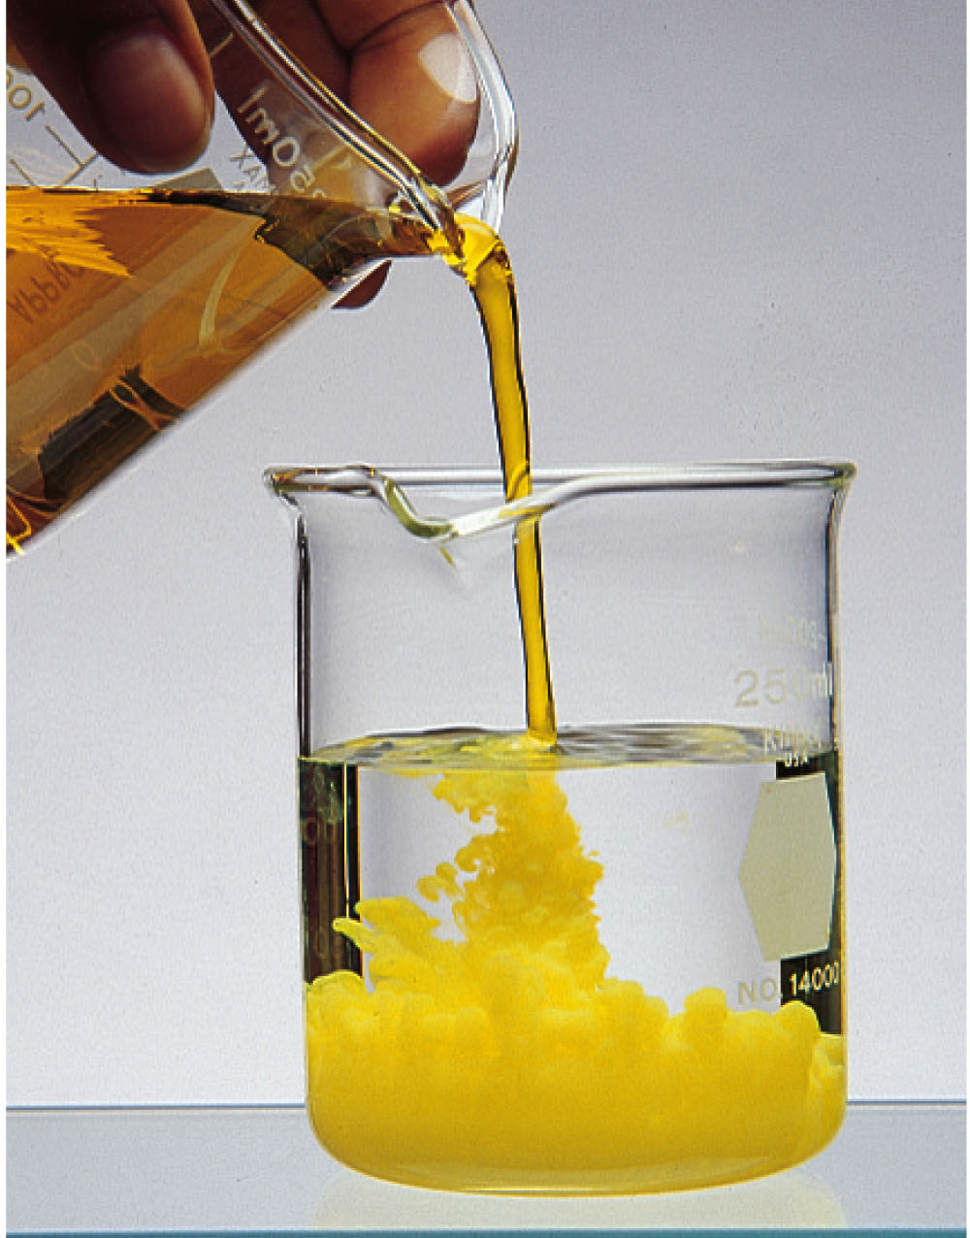
What is a clue that a chemical reaction has occurred?
“A solid forms when a solution of sodium dichromate is added to a solution of lead nitrate.”
a) A gas forms.
b) A solid forms.
c) Bubbles are present.
d) A flame is produced.

Slide 7
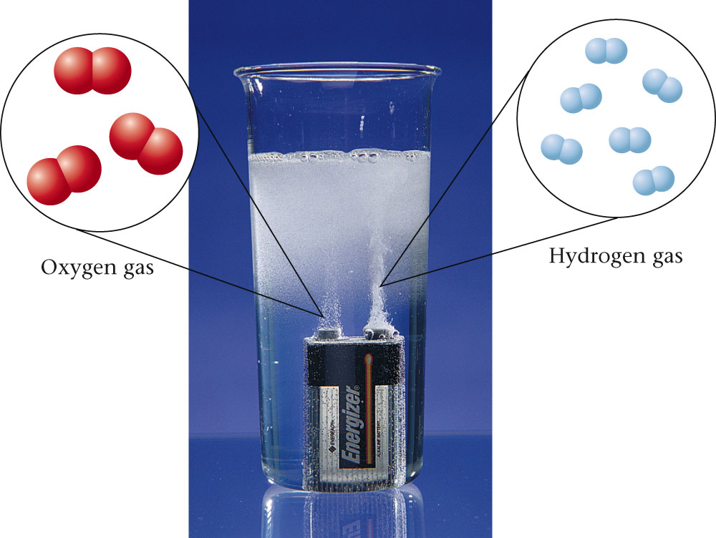
What is a clue that a chemical reaction has occurred?
a) The color changes.
b) A solid forms.
c) Bubbles are present.
d) A flame is produced.

Slide 8
Chemical Equations
Chemical equations show what substances are involved in the reaction.
The starting substances that will be changed in the reaction are called reactants.
The final substances that were formed by the reaction are called the products.
CO₂ + H₂O ---> C₆H₁₂O₆ + O₂
Reactants Products

Slide 9
Balancing Chemical Equations
This equation is unbalanced. In other words it has the proper molecular formulas but not the correct number of atoms. Can you balance the equation?
CO₂ + H₂O ---> C₆H₁₂O₆ + O₂
_{1 Carbon 6 Carbons}
_{2 Hydrogens 12 Hydrogens}
_{3 Oxygens 8 Oxygens}

Slide 10
The Law of Conservation of Mass
The principle that lies at the heart of the balancing process is that atoms are conserved in a chemical reaction.
Atoms are neither created nor destroyed.
The same number of each type of atom is found among the reactants and among the products.

Slide 11
Activation Energy
Most chemical reactions require an energy source in order to start the reaction.
The minimum amount of energy that is required to start a reaction is called the Activation Energy.
A Catalyst is a substance that lowers the activation energy of a chemical reaction. Another important property of a catalyst is that it does not get used in the reaction. That means it is reusable.

Slide 12
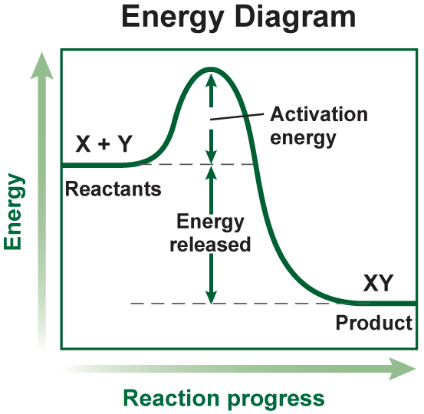
Activation Energy with Endothermic and Exothermic Reactions
Energy of Reactions
The activation energy is the minimum amount of energy needed for reactants to form products in a chemical reaction.

Slide 13
This reaction is exothermic and released heat energy.
The energy of the product is lower than the energy of the reactants.
Heat is given off – feels hot to the touch!

Slide 14
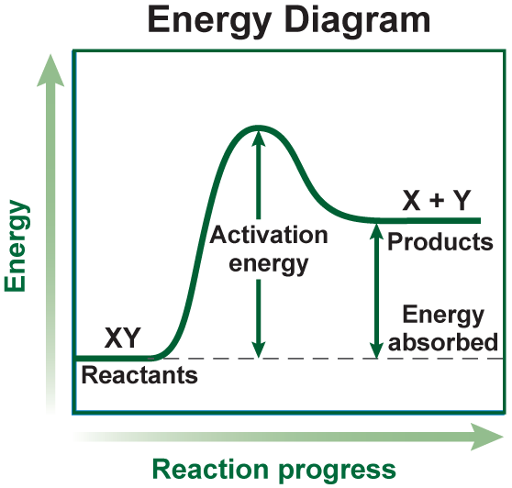
This reaction is endothermic and absorbed heat energy.
The energy of the products is higher than the energy of the reactants.
Heat is absorbed – feels cold to the touch!

Slide 15
Enzymes
Enzymes are special proteins essential to life that act as biological catalysts.
They speed up normal body reactions without being used up in the reaction themselves.
Without enzymes, our bodies would not function. Normal metabolism requires thousands of complex chemical reactions.
Without enzymes, these reactions in our bodies could not take place.

Slide 16
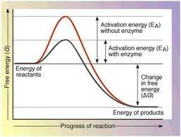
Enzymes and Activation Energy

Slide 17
Examples of Enzymes and their Function
Amylase – Breaks down starches
Cellulase – Breaks down cellulose
Lactase – Breaks down dairy products
Lipase – Breaks down fats
Maltase – Breaks down grains
Protease – Breaks down proteins
Sucrase – Breaks down sugars

Slide 18
How an Enzyme works
Enzymes can only react with certain reactants.
It kind of works like a puzzle. Specific reactants in a reaction are called substrates. Substrates have a specific site that only matches with a specific enzyme. The matching site is called the active site.
Once the active site on the substrate matches with an enzyme, the enzyme causes the substrate to change shape or form to make new products. Then the enzyme is released.

Slide 19
Enzymes and Substrates
Enzymes can be destroyed or affected by certain factors such as high or low pH and high or low temperatures. Optimum enzyme activity in humans and most endotherms is 37 C⁰ or 98.6 F⁰.

