Slide 1
Planet ocean
GEMs – Ocean Currents
ACTIVITY 1

Slide 2
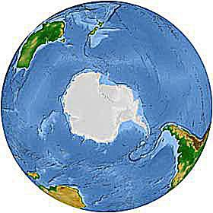
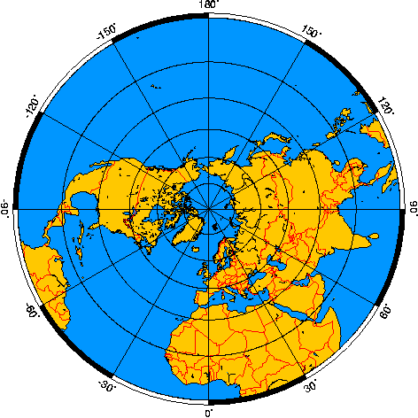
Ocean review!
Water covers much more surface of Earth than land – about 71%
The Southern Hemisphere is about 80% water and the Northern Hemisphere is about 60% water.

Slide 3
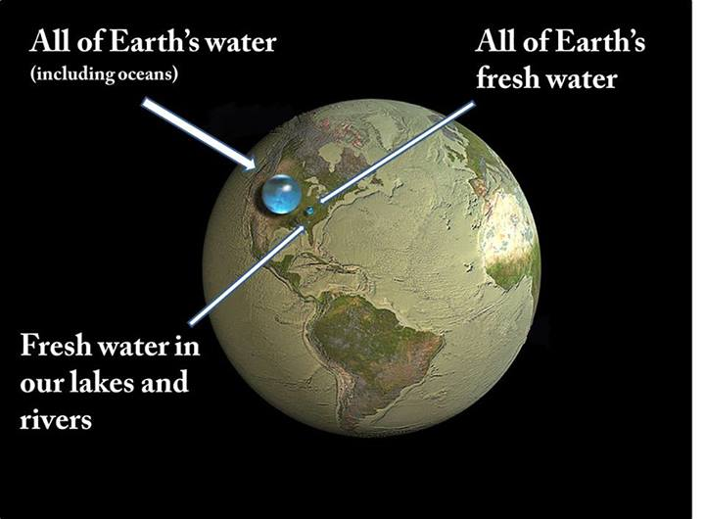
Ocean review! Cont.
The ocean is the most dominant, most important feature on the surface of Earth, and helps distinguish our planet from the other planets in the Solar System. The ocean does not dominate Earth as a whole since it is very thin (about four kilometers deep compared to the approximately 100,000 kilometer depth of the planet.

Slide 4
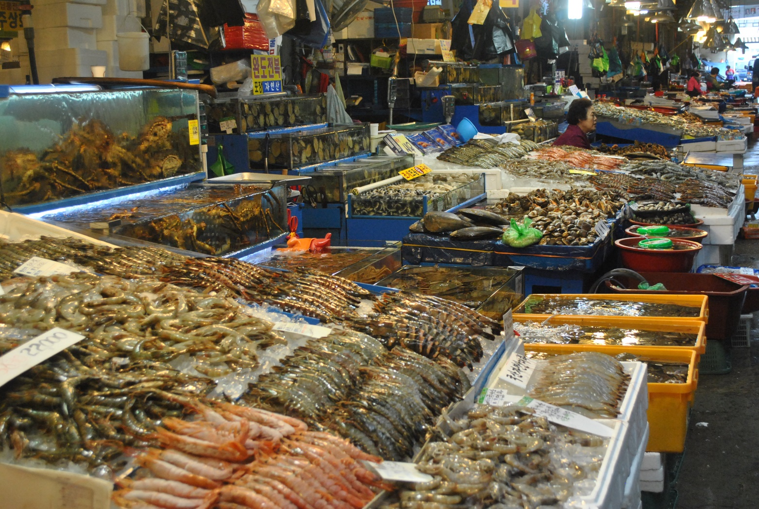
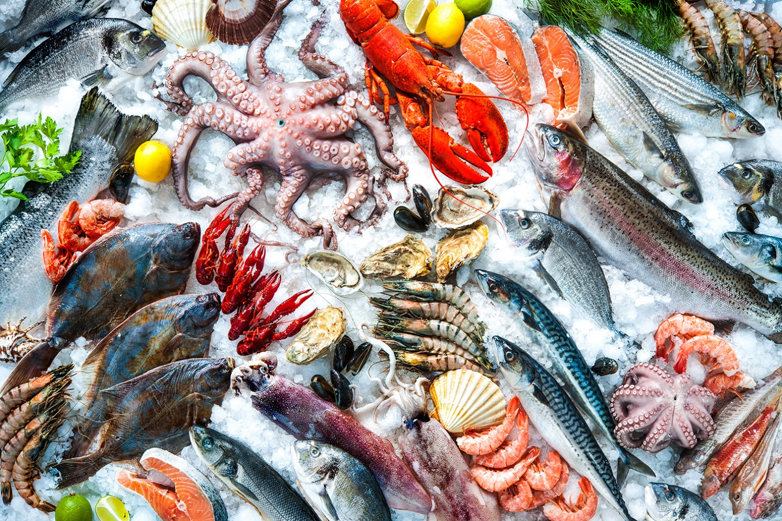
Ocean review! Cont.
Much of the world’s food supply comes from the ocean.

Slide 5
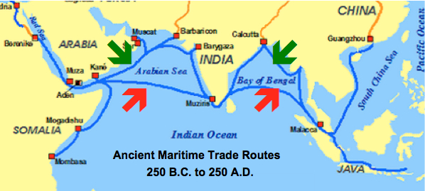
Ocean review! Cont.
Coastlines have always been places where ideas and good have been exchanged.
A huge part of human history, migrations, colonization, trade routes, and wars, up until the time of air travel, is the story of how people have used wind and currents in their travels from one continent to another.

Slide 6
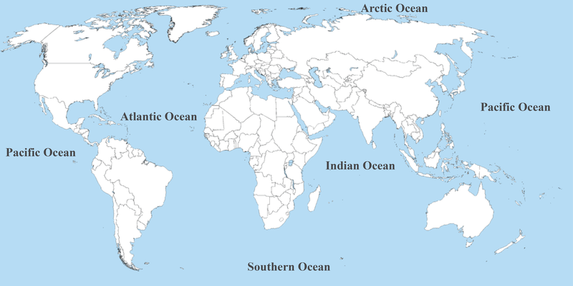
Ocean review! Cont.
All the major oceans are connected. THERE IS ONLY ONE OCEAN!! Although we call it different names in different places, there are no real ocean boundaries.

Slide 7
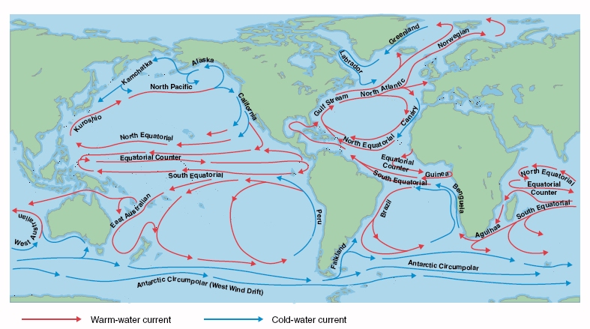
Ocean review! Cont.
Ocean currents are huge amounts of sea water moving fairly steadily in a fairly constant direction over long distances.
Ocean currents move water throughout the world ocean.

Slide 8
There is only ONE ocean! Our Earth is covered by one interconnected world ocean that circulates around all the continents.

Slide 9
A human versus the planet activity
Our planet is so big it is hard to imagine how all the parts work together. Sometimes it helps to make a comparison to something smaller that we are more familiar with – so, let’s compare the planet to an organism we know: a human, like us!

Slide 10
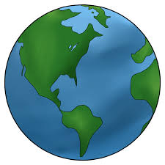
A human vs. the planet

