Slide 1
Surface currents
GEMs – Ocean currents
Lesson 2

Slide 2
Thought Swap!
Form two lines facing each other. There should be 6 inches between shoulders.
First question to discuss: When and where was the last time you went swimming or wading?
Switch!
Second question to discuss: Did you feel a current? What is a current and how could you tell that a current was happening?
Switch!
Third question to discuss: where and when have you ever noticed cold and warm layers of water?
Switch!
Last question to discuss: describe some of the ways you can think of to make a current in a pool, tub, or even a glass of water.

Slide 3
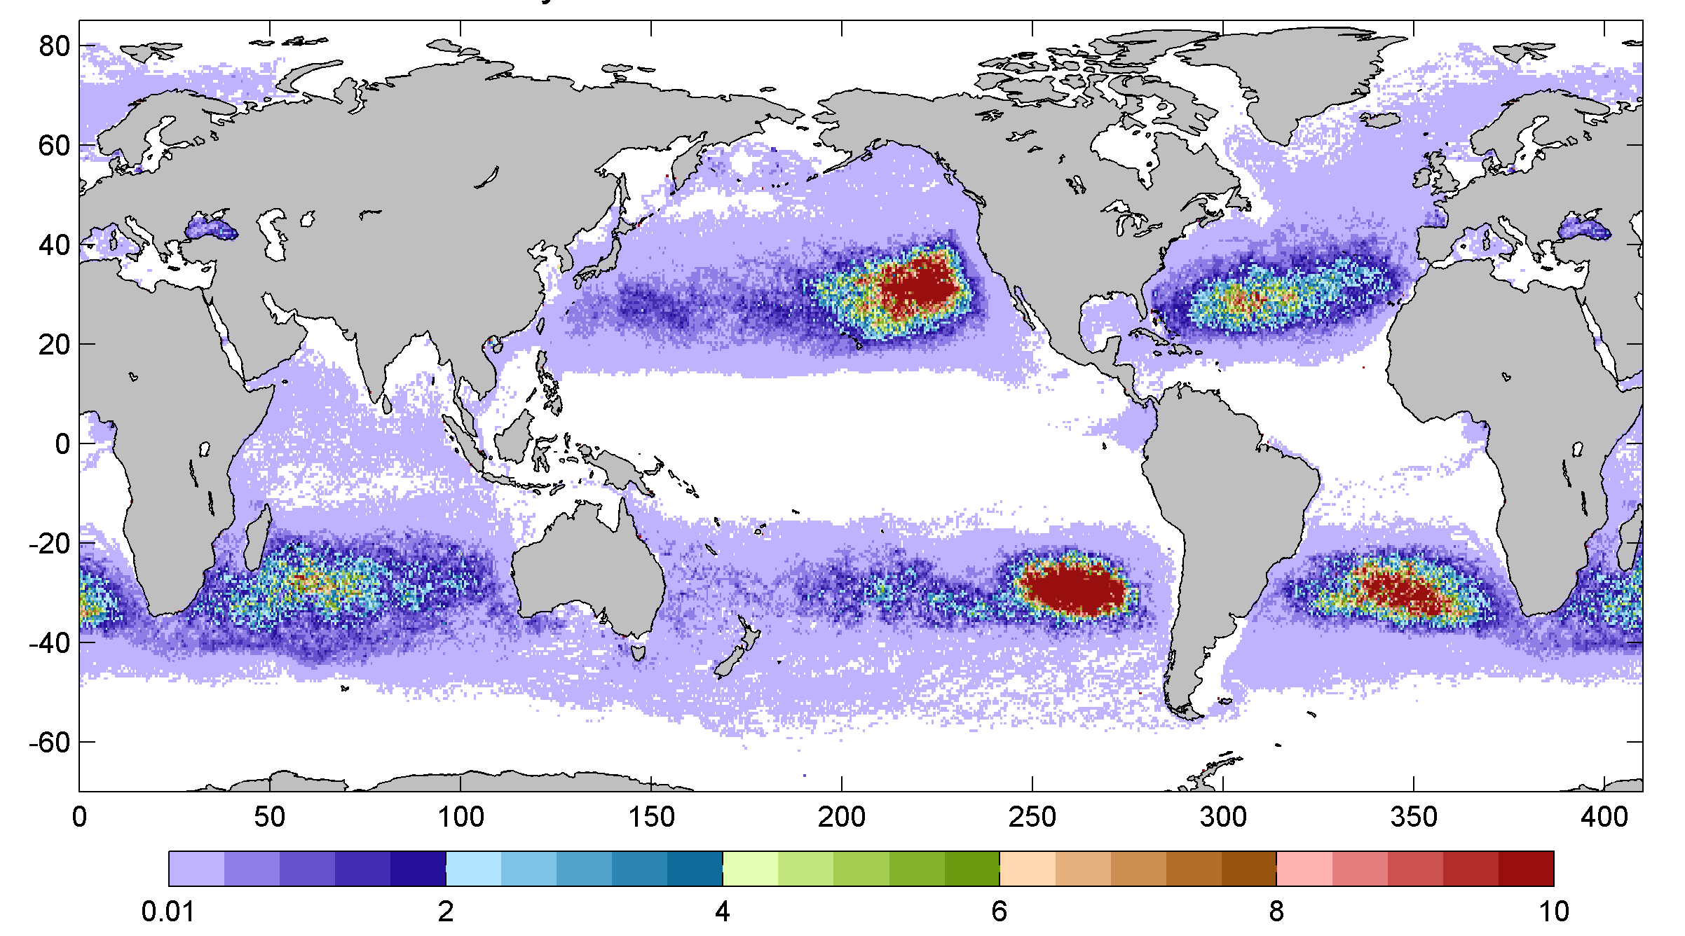

Slide 4
Where does our “waste” go?

Slide 6
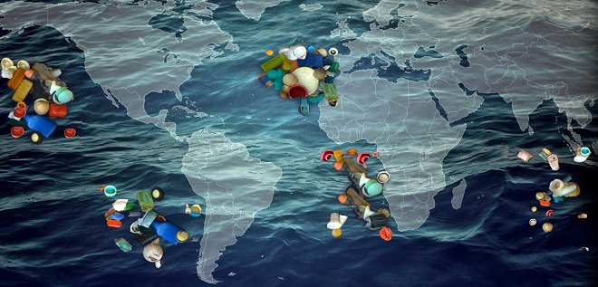
Ocean garbage patches – there are 5

Slide 7
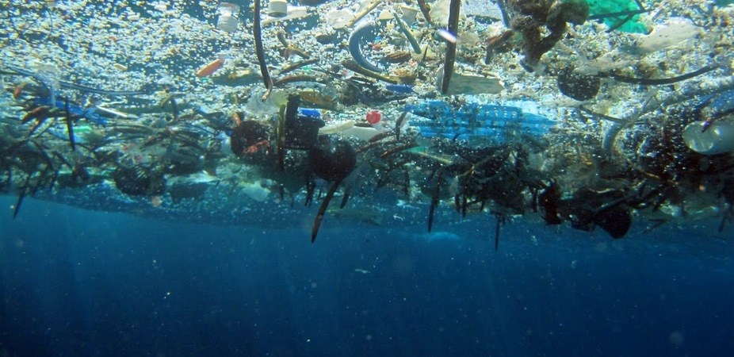
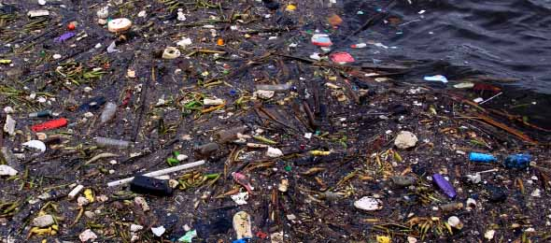

Slide 8
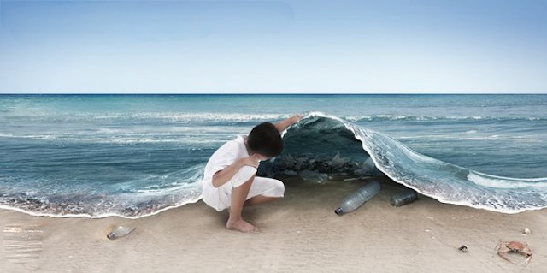

Slide 9
Exploring our ocean’s garbage patches:
You will demonstrate ocean currents caused by wind using a shoe box of water and a straw. Take turns being the wind, one at a time!
Label your paper “Ocean currents caused by wind”
Explore with different types and directions of wind. Blow gently through the straw straight across the surface of the water in the shoebox. Try not to cause too much turbulence.
Take note of what is happening to the water. Draw a picture or diagram of what you see.
Stop!

Slide 10
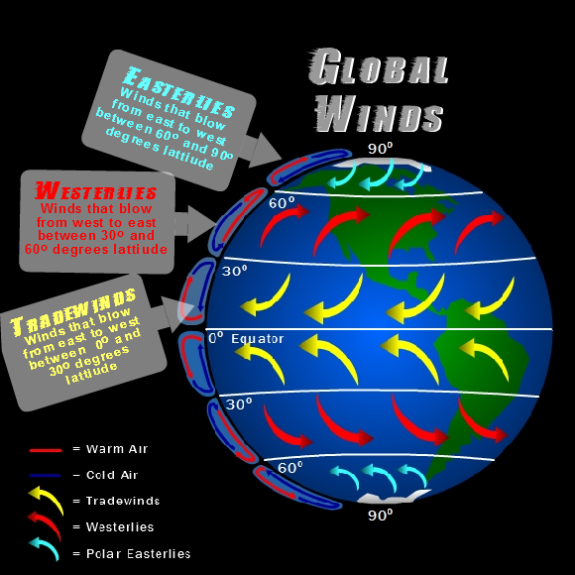
winds
As the earth spins on its axis, winds are blowing on the surface of our oceans. At the equator, the winds are mostly blowing in the westward direction (towards the west - Tradewinds).
Between 30 and 60 degrees, the winds are mostly blowing in the eastward direction (Westerlies)

Slide 11
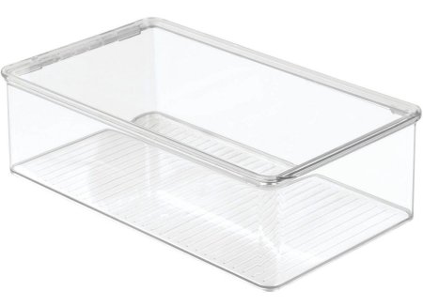
Surface currents
Think of your shoe box as the pacific ocean. At the center of your box is the equator. Blow gently across the center of the water. Think of it as blowing towards asia/japan. Try to set up a good current in your box.
Your teacher will come around and put trash in your ocean. Continue blowing.
Write down your observations. Draw a sketch using arrows of water and trash movement.

Slide 12
Garbage “patch?”
How does our worlds trash accumulate into patches?
Manipulate your wind to create “gyres” with your ocean water.
Gyre – a large system of rotating ocean currents. *Large swirl of ocean water
What happens to the trash?
Make observations and draw pictures/diagrams.

Slide 13
Ocean basins and ocean currents
What do ocean basins/features have to do with ocean currents? Compare your shoebox of water with the pacific ocean. What are the parts?
Draw a diagram of how your system represents an actual ocean.

Slide 14
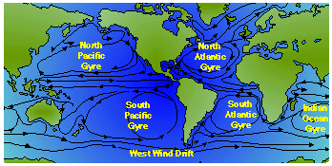

Slide 16
Things dumped into the ocean may be distributed by currents throughout the ocean

Slide 17
Wind and the temperature differences between masses of water are two factors that cause currents

Slide 18
Winds blowing across the surface of the ocean combined with other factors – cause major circulating currents, or GYRES

